Slide 1
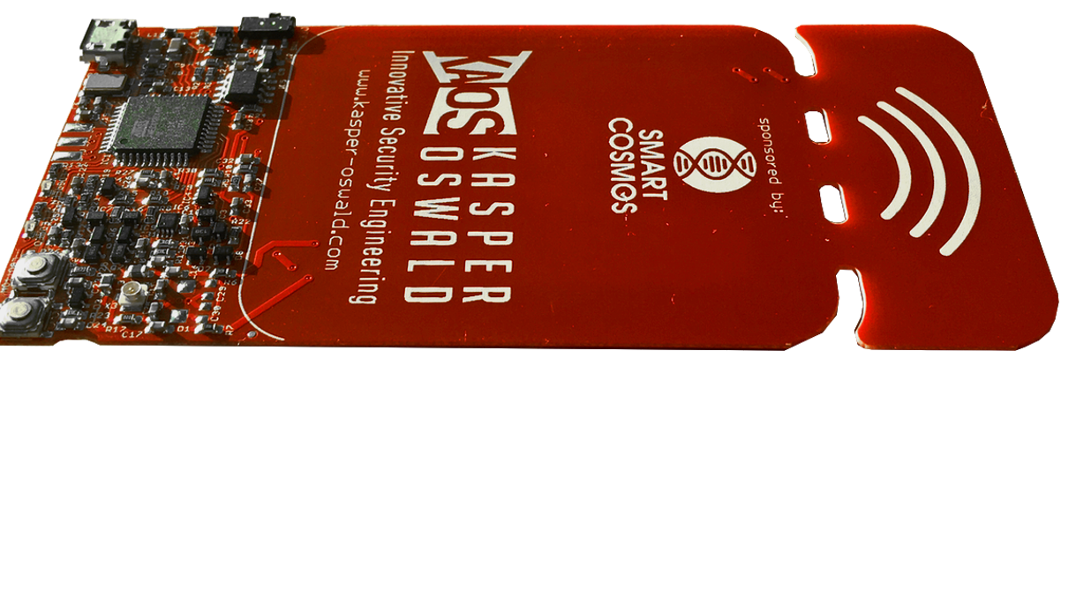
Chameleon Mini Rev. G
Scope und Features

Slide 2
Features:
A versatile NFC emulator, log tool, and a basic RFID reader.
Supported RFID Configurations:
Configuration Command | Codec | Description
MF_ULTRALIGHT | ISO14443A Emulation | Emulates a MiFare Ultralight card
MF_CLASSIC_1K | ISO14443A Emulation | Emulates a MiFare Classic 1k card
MF_CLASSIC_4K | ISO14443A Emulation | Emulates a MiFare Classic 4k card
MF_CLASSIC_1K_7B | ISO14443A Emulation | Emulates a MiFare Classic 1k card with 7-byte UID.
MF_CLASSIC_4K_7B | ISO14443A Emulation | Emulates a MiFare Classic 4k card with 7-byte UID.
ISO14443A_SNIFF | ISO14443A Emulation | Currently incomplete. Sniffs ISO14443A communication between a reader and a card.
ISO14443A_READER | ISO14443A Reader | The Chameleon-Mini works as a reader and can process different procedures in order to obtain a cards UID etc.

Slide 5




READER Commands:
IDENTIFY – Identifies the type of a card in reader range and returns the type. After getting the tag details, the reader gets timeout and disables the field. This command works only when chameleon is configured as Reader.
Output
Output
Here ATQA, SAK represents manufacturer, tag type respectively.

Slide 6
GETUID -

Slide 7
Important Links:
Upgrade Firmware through USB:
https://htmlpreview.github.io/?https://raw.githubusercontent.com/emsec/ChameleonMini/master/Doc/Doxygen/html/_page__getting_started.html
Chameleon Mini Documentation:
http://htmlpreview.github.io/?https://github.com/emsec/ChameleonMini/blob/master/Doc/Doxygen/html/index.html
Chameleon Mini Reader Commands:
https://htmlpreview.github.io/?https://raw.githubusercontent.com/emsec/ChameleonMini/master/Doc/Doxygen/html/_page_14443_a_reader.html

